Slide 1
TULANE UNIVERSITY CONCUR INVOICE
NEW SUPPLIER/VENDOR CREATE
Revised 6/5/24

Slide 2
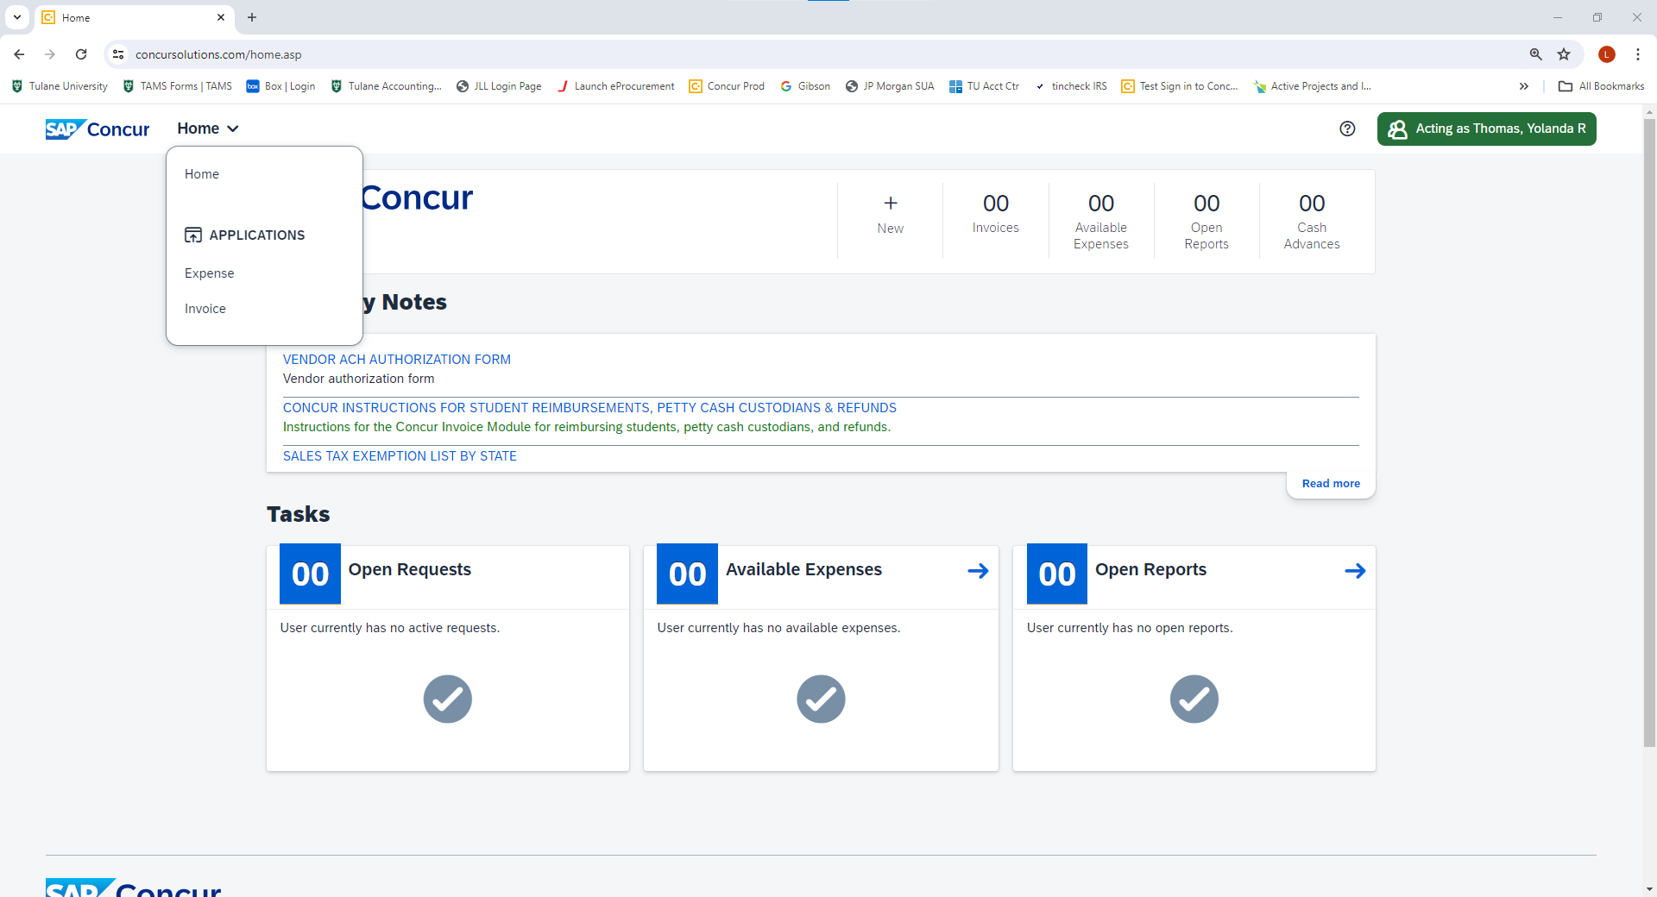
Click the home arrow and select Invoice from the drop-down list

Slide 3
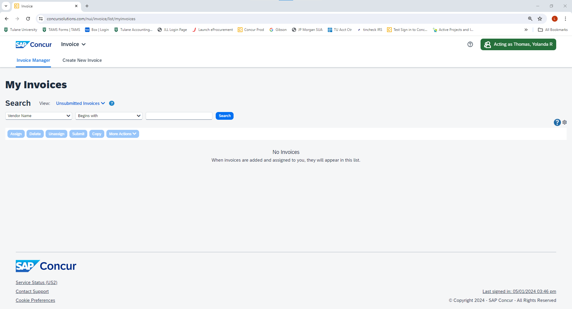
Click Create New Invoice Link

Slide 4
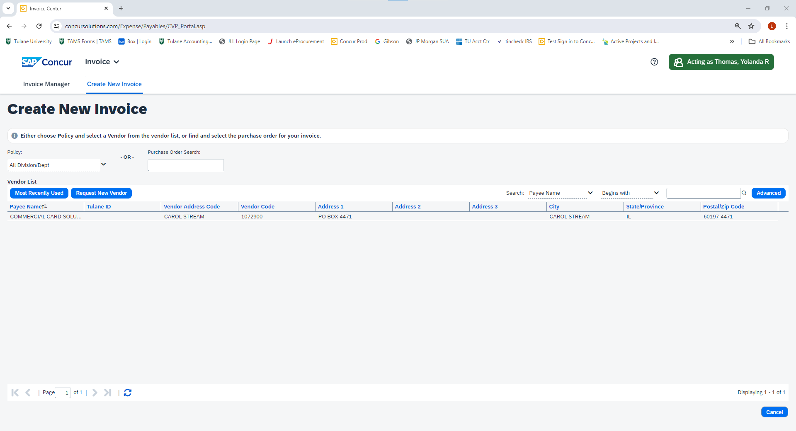
Click the Request New Vendor link

Slide 5
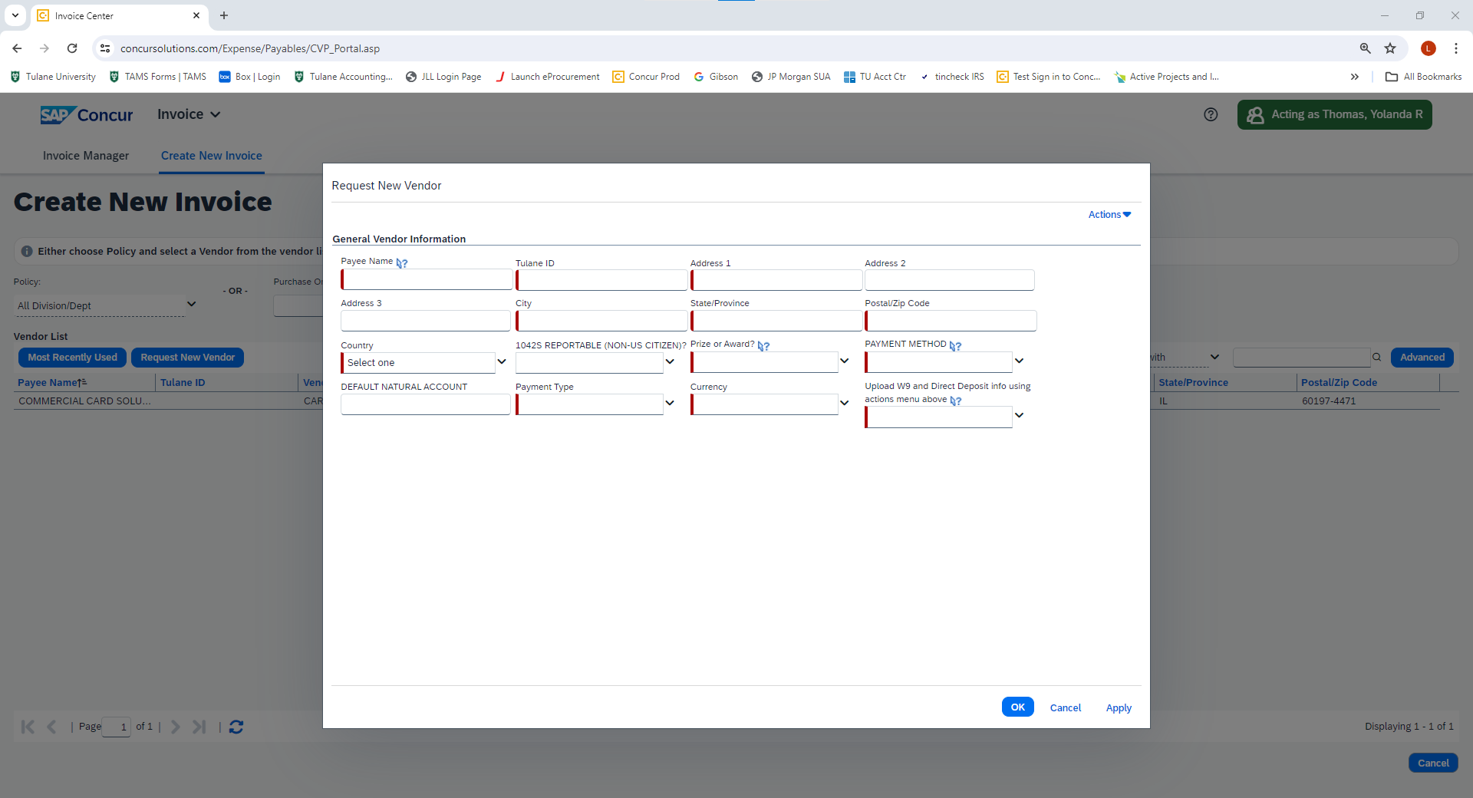
15)
1)
2)
3)
4)
5)
6)
7)
8)
9)
10)
11)
12)
13)
Enter the name of the payee. Use the format (Last Name, First Name, Middle Initial)
Enter the Tulane ID number of the payee. If the payee is a non-Tulane affiliate (refunds only) enter 123456789. The message “Vendor Save Status” will appear when Apply is clicked when the form is completed. Click the Yes link and the new vendor request will update the invoice.
Enter the home mailing address for the payee.
Enter the home mailing city for the payee.
Enter the home mailing state for the payee.
Enter the home mailing zip code for the payee.
Enter the home mailing country for the payee.
Choose Yes or No to indicate if this payee is a non-US citizen.
14)

Slide 6
15)
1)
2)
3)
4)
5)
6)
7)
8)
9)
10)
11)
12)
13)
Select Yes or No to determine if this request for payment is a Prize or Award (Students
Only). If Yes, attach a completed W9 form using the Actions button above (14).
10) Select ACH or Check for domestic payments or EFT (Wire Transfer for foreign payments
only). If ACH or EFT is selected, attach the Authorization for Direct Deposit or Tulane Wire
Transfer form using the Actions button above (14).
11) Choose whether the payment will be mailed, picked up or sent by direct deposit (ACH).
12) Select USD-US, Dollar. If an EFT (Wire Transfer is going to be issued in foreign currency the
Tulane Wire Transfer form attached using the Actions button (15) will indicate the foreign
currency.
14)

Slide 7
15)
1)
2)
3)
4)
5)
6)
7)
8)
9)
10)
11)
12)
13)
13) Indicate Yes or No to indicate whether or not the Direct Deposit Authorization, W9 or W8
form has been attached.
14) When all required fields are completed click Apply. If you entered 123456789 for a Non-
Tulane affiliate refund payment only, the message “Vendor Save Status” will appear
when the Apply link is clicked. Click the Yes link and the new vendor request will
update the invoice.
15) After you click apply from step 14 and you have a direct deposit authorization or a W9/W8
form to upload, click the Actions button and select Upload Image and save.
14)

Slide 8
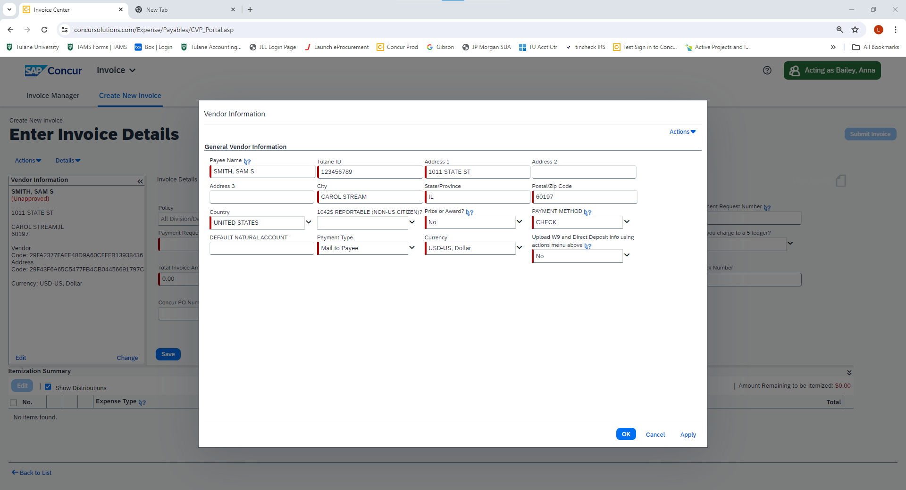
Click the OK link to continue entering the payment request information.

