Slide 1
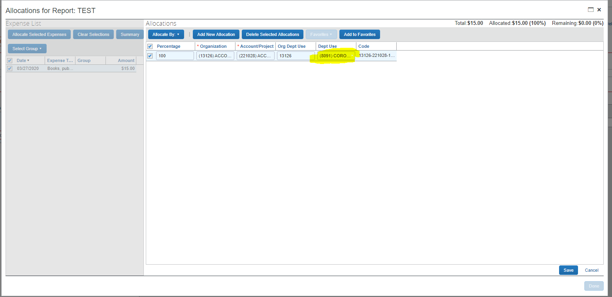
When you allocate in Concur you use the dropdown arrow in the Dept Use field of the allocation. Choose 8091 from the list of available department use codes and then save.

Slide 2
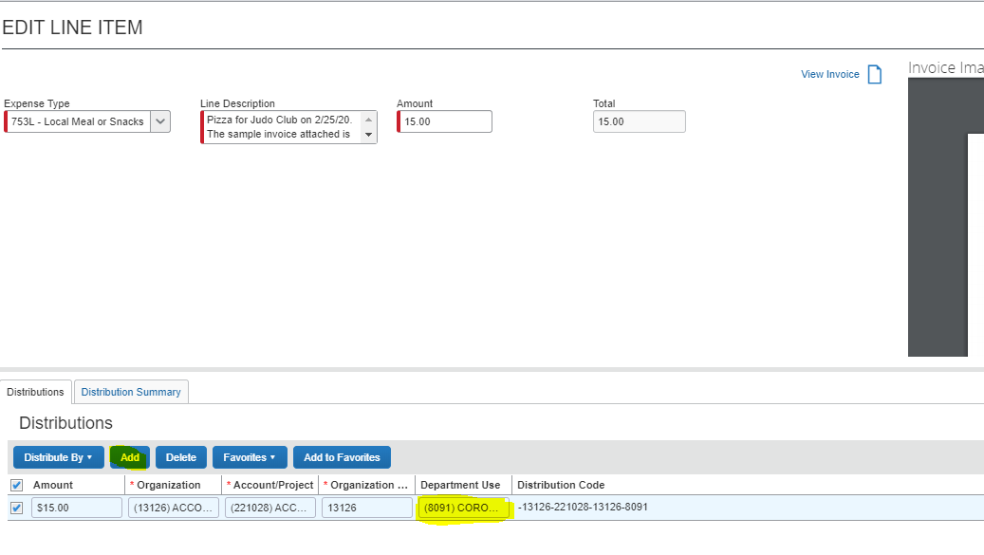
When allocating in Concur Invoice you use the drop down arrow in the Department Use field and select 8091. Be sure to save your work.

