Slide 1
Changing Profile Settings
For Charging Accounts Outside Of Your Division

Slide 2
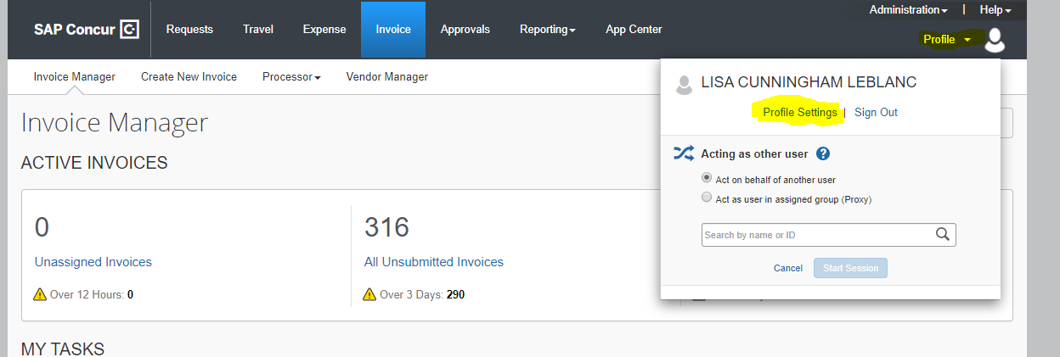

Slide 3
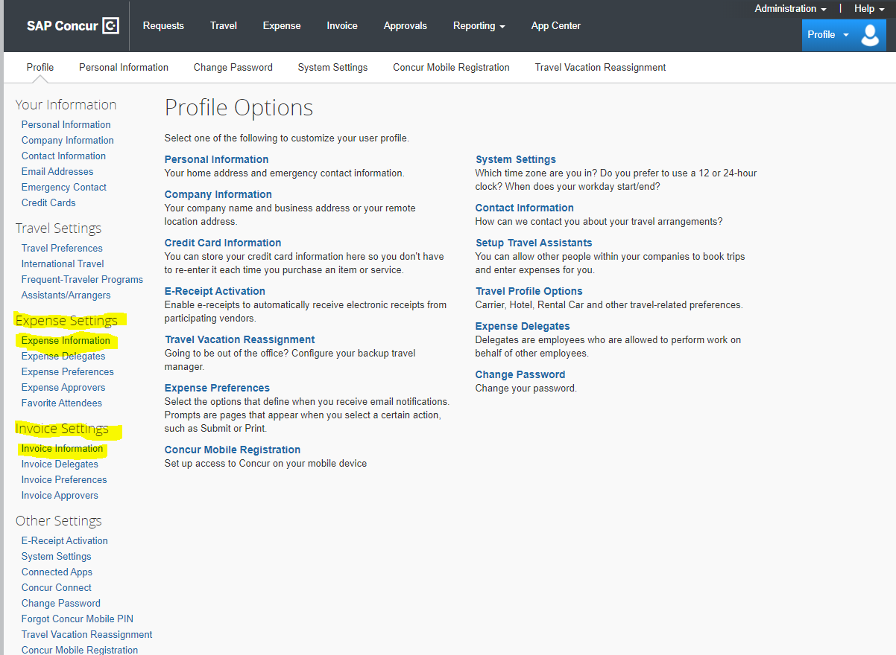
To change your department org on your profile for Concur Expense select the Expense Information link. To change your department org on your profile for Concur Invoice select the Invoice Information link

Slide 4
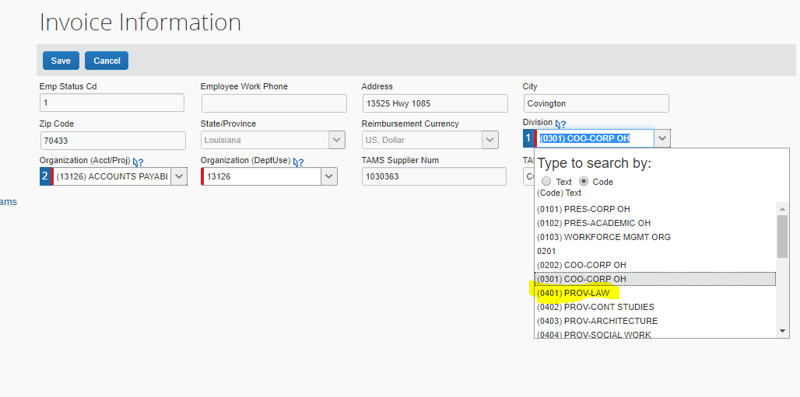
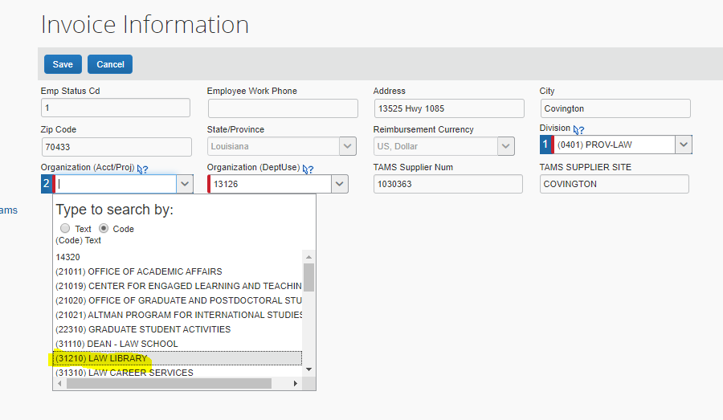
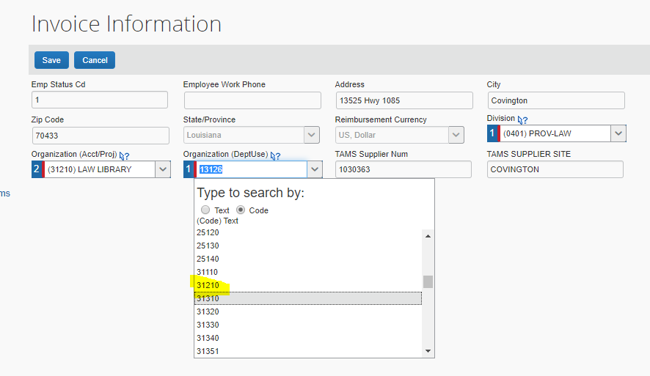

Slide 5
Notice that the org number defaulting on your new invoice request is the org number that you changed and saved on your Invoice profile. Once you have completed processing for this org number you should go back to your profile and change your division and org codes back to your home division and org codes. Be sure to save your changes. You cannot allocate to accounts in different divisions on the same request. If this is something that you will need to do you will have to charge all to one division and do a correction IT to allocate to the other division(s).

