Slide 1
ALLOCATING EXPENSES YOU CANNOT CHANGE THE ORG AND ACCOUNT NUMBER ON THE HEADER!
Allocating to your own Organization and Accounts has been covered in the PPT “CREATING AN EXPENSE WITH PER DIEM AND CREATING AN ITINERARY”
Allocating to an Organization within your division
Allocating to an Organization not in your division

Slide 2
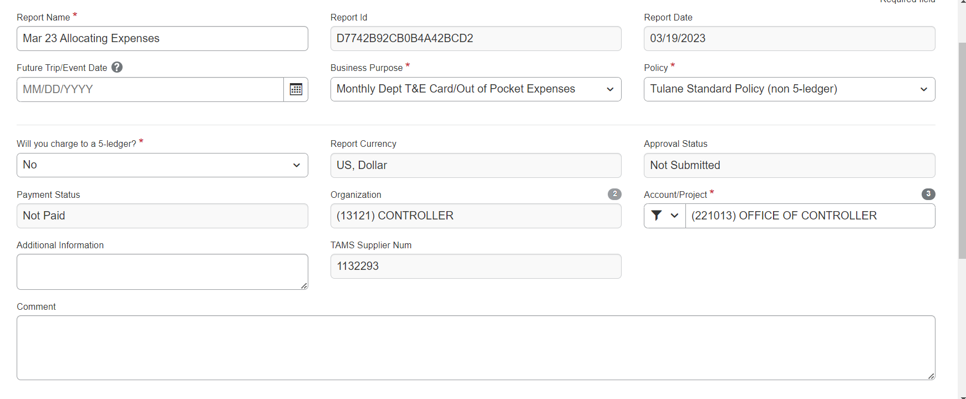
ALLOCATING EXPENSES TO A DIFFERENT ORGANIZATION & ACCOUNT WITHIN YOUR DIVISION
CLICK ON CREATE AN EXPENSE REPORT
FILL OUT THE REPORT HEADER AND CLICK SAVE

Slide 3
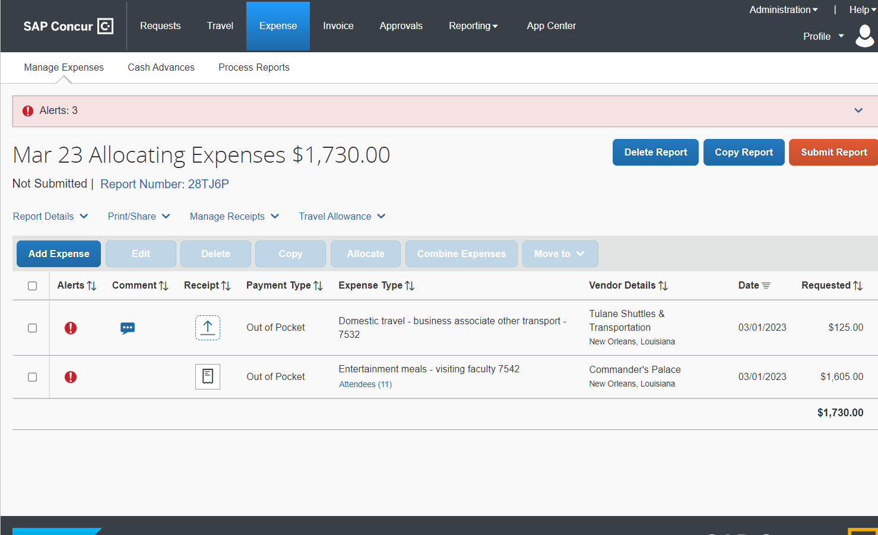
Add expenses to your expense report. Attach receipts to the expense report
Report is now ready to be allocated-red exclamation point is the warning the expense has to be allocated

Slide 4
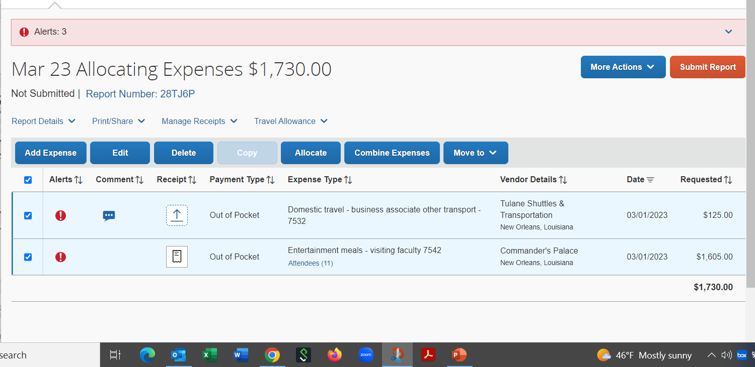
Click in the top box to highlight all expenses that are going to be allocated.
Click on the option “Allocate expenses.”

Slide 5
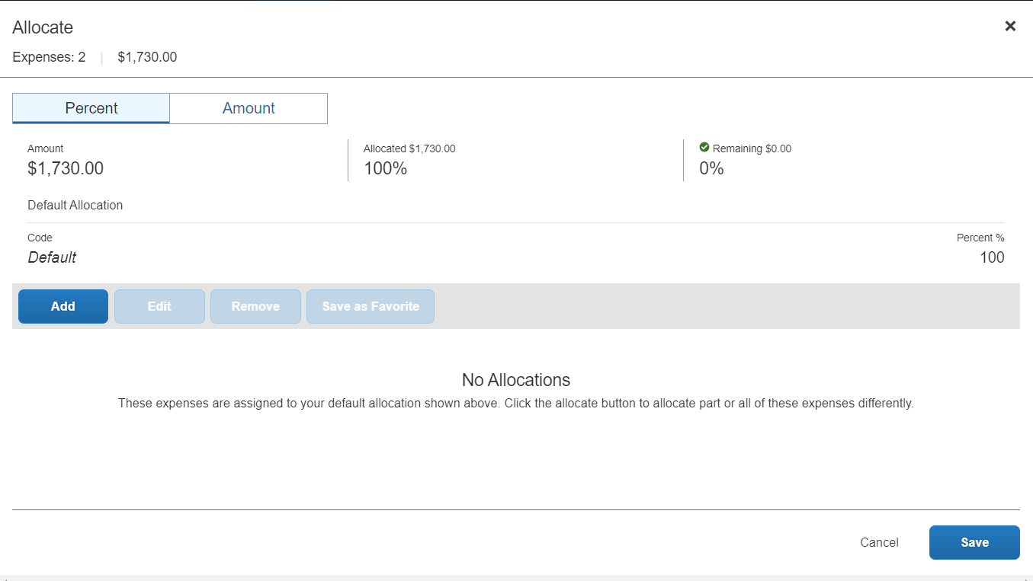
Clicking on Allocation will take you to the allocation screen.
Once you click on add a dialogue box appears and shows the default allocation that is on the report header.

Slide 6
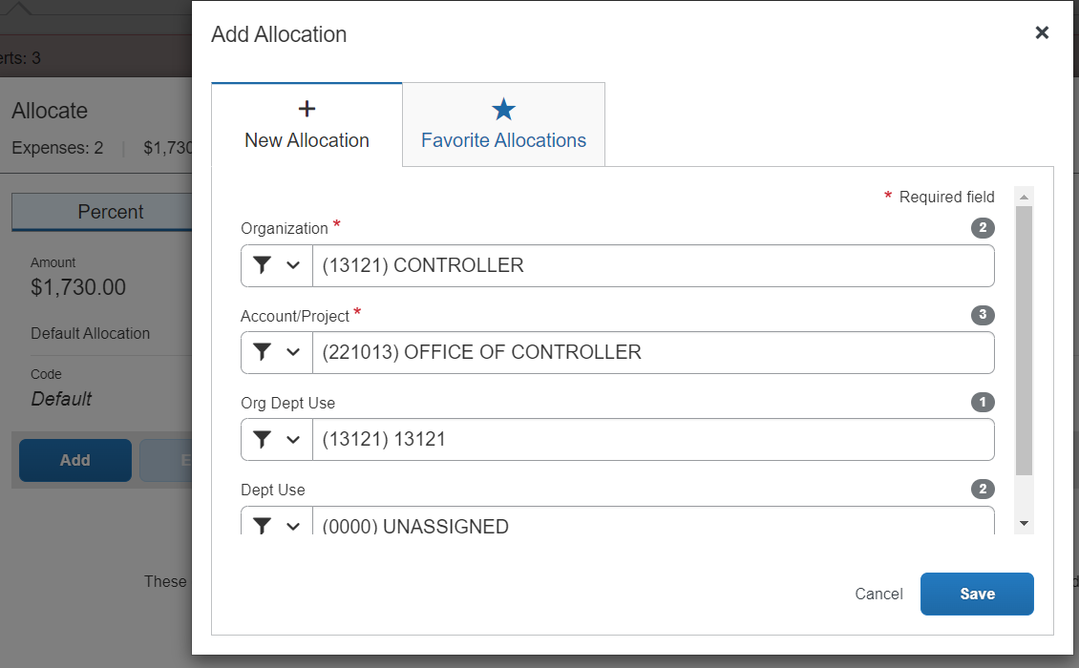
Once you click on add you will see the dialogue box with the default allocation from the report header.
This is where you will change the Org and account number that you want to allocate to.

Slide 7
The Org # and Account # the expenses will be allocated to belongs to the same Division as the Org # on the header. This allows us to change the allocation without having to change the profile(your default Org and account.)before creating the report. Click on the first Org field and you will see the Orgs you can allocate to.

Slide 8
Click on the first Organization field and choose the Org you need. Click on the drop-down list under account/project and choose the account you need Click on the Org/Dept Use field and choose the same Org as in the first field. Click on Dept Use and enter (0000 unassigned) unless your dept uses Dept Use Codes. Click save

Slide 9
Once you have clicked save, this screen will appear. Click in the box next to Organization and it will highlight the allocation. Click Save

Slide 10
Once you click save on the previous screen, the expenses pane now appears. The red exclamation point indicates that you need to allocate your expenses. Click on both expenses to highlight Click on Allocate

Slide 11
Once you click allocate on the previous page, this dialogue box appears. Click on add and it will take you to the bring up the allocation dialogue box.

Slide 12
Once you click on add, the account allocation page appears. The information that appears is the default Org and account that the employee belongs to.

Slide 13
This is the allocation dialogue box where you will choose the Orgs and Accounts you want to allocate to. Click in the first Organization box and a list of Orgs in your division you can allocate to appears.

Slide 14
Click in the first Organization field and choose Org to be allocated. Click on the account drop-down box and choose account to be allocated to. Click on Org/Dept User and enter the Org # that is in the first Org field. **Note- The two Org #s must match, or you will get an error. Also, sometimes you have to type in the actual Org # in the second Org field then click on the dialogue box that shows it. Enter in the dept use field (0000) unassigned. Click save.

Slide 15
Once you save your allocations on the previous screen, you now have to click on the allocation that now shows in this box. Click on the allocation and then click save.

Slide 16
The last column will show you that each expense has been allocated. Your report has no alerts(errors) that need to be addressed in order to submit You can now click submit report (or if working as a delegate, click notify.)

Slide 17
Your report now shows that it has been submitted and is in Pending External Validation.

Slide 18
ALLOCATING TO AN ORG AND ACCOUNT OUTSIDE OF YOUR DIVISION
BEFORE BEGINNING A REPORT WHERE YOU WILL BE CHARGING AN ORG AND ACCOUNT OUTSIDE OF YOUR DIVISION, YOU MUST GO TO THE CONCUR RESOURCES PAGE.
OPEN THE DIVISION TO ORG LIST AND LOOK FOR THE ORG YOU WANT TO ALLOCATE TO AND LOOK AT THE DIVISION IT BELONGS TO.
YOU MUST KNOW WHICH ORG THE ACCOUNT YOU WANT TO ALLOCATE TO BELONGS TO.

Slide 19
Before starting a report where you will allocate to an Org that is not in your division, you must change your profile, but if working as a delegate, go in as the delegate and change their profiles. Click on Profile Click on Profile Settings

Slide 20
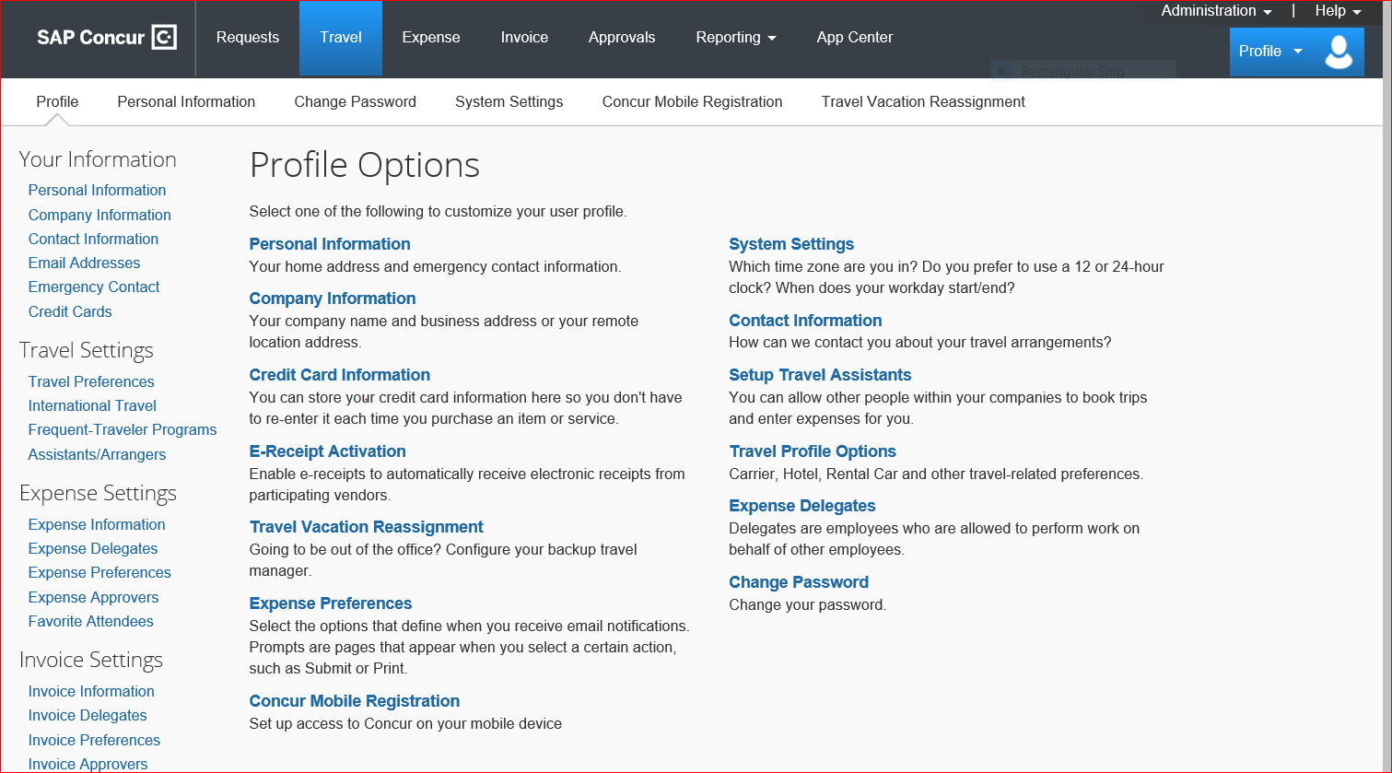
You are now on the Profile Options Page.
In the left-hand column under the “Expense Settings” choose the “expense information” option.

Slide 21
This is the screen you change your profile information on in order to access the Org and division out of your Division. Click on the division drop-down list and choose the correct division, (Division change must always be done first.) Click on the Organization Acct/Proj and enter the Org you will allocate to. Click on the Organization Dept user and enter the Org you will allocate to, Click Save

Slide 22
Click on Create a New Report You will now see that you (or your delegate) now has access to the Org you need to allocate to. Click in the account/Project drop-down list and choose the account needed. Finish filling out the rest of the report header and click save.

Slide 23
Create your expense report by adding your expenses and receipts. As you will see by the alerts window and next to the expenses themselves, you need to allocate these expenses.

Slide 24
You will now click on Add Expense Click on Allocate once you click on expense it will become available. All fields at the top stay grayed out until you click on add expense.

Slide 25
This is the allocation page. Click add to bring up the allocation dialogue box. If you choose to allocate to more than one account, you can allocate by either percent or amount. Click on the method you prefer.

Slide 26
The allocations now appear as they do on the report header. The expenses are being allocated to the Org and account you need to allocate outside of your division. You can either keep as is or you can change the account # by clicking in the account drop-down list Click save

Slide 27
This is the final allocation field Click the box next to the allocation to highlight it Click Save

Slide 28
Click in the boxes next to the expenses to clear them The report had no alerts(errors) that require to be corrected Your report is now ready to submit

Slide 29
You will now see that your report is in your open expense reports and ready to submit.

