Slide 1
CREATING AN EXPENSE REPORT
This PowerPoint will cover creating an Expense report which will include the following:
Creating an Itinerary with Per Diem
Entering Expenses and uploading Receipts
Itemizing Hotel Charges
Allocating Expenses
Meals with attendees
Printing and Submitting Expense Report

Slide 2
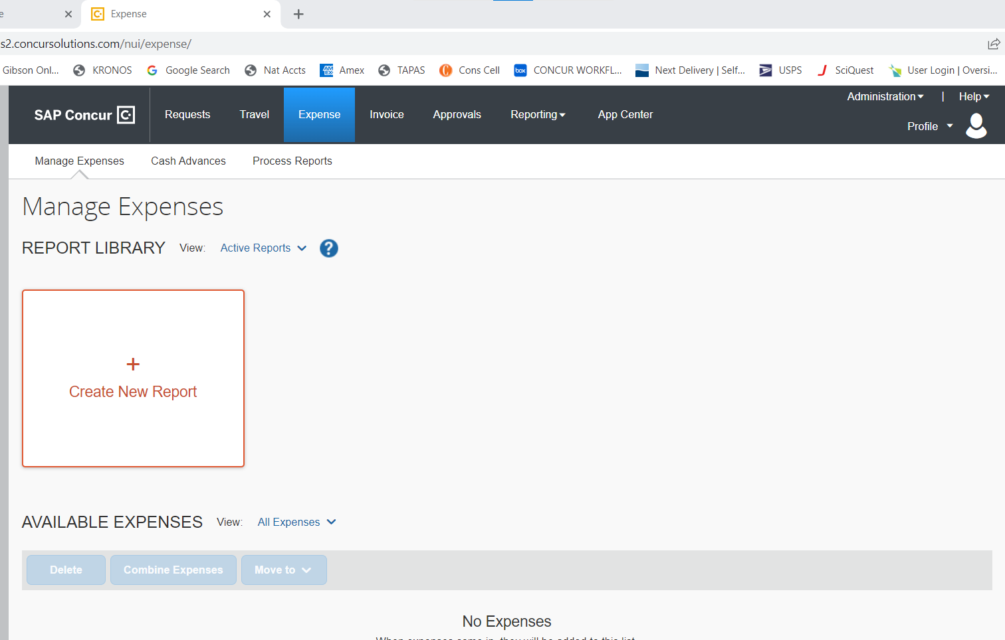
After signing into Gibson Online and clicking on the Concur link, click on the expense tab This will take you to the main expense report screen where you will click in the box “create a new report.”

Slide 3
You are now at the “Report Header.” This is where you start creating the report. Note** The Organization and Accounts that appear on the report header CANNOT be changed. This is the default information on the person who the report is for. Changing this information will be covered later

Slide 4
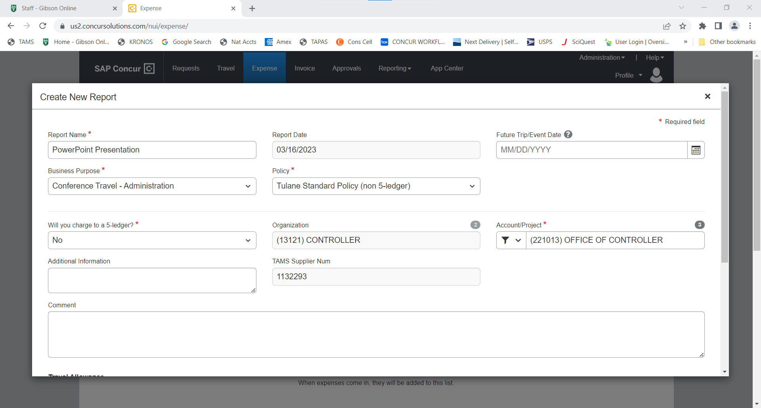
Report name: Month, year, Name, Short Description (i.e., T&E Exp, ABA Conf. etc) Choose the Business Purpose from the drop-down menu. Some Business Purposes require additional information which the system will prompt for. At the bottom of this page, it will ask you if per diem is requested. Click save.

Slide 5
If you charge expenses in advance for a trip in the future, you must fill out the “Future Trip/Event Date.” Name the report month for the month you will be traveling.

Slide 6
**Charging a grant account requires two additional steps which are mandatory. If charging a grant account for any expense in the report, you MUST choose yes under “will you charge a 5 ledger” and you MUST then change the Policy to “Sponsored Project Policy.” Choose 5 ledger account

Slide 7
You will now create the itinerary to add per diem to the trip’s expenses Click on create a new itinerary Enter the 1st leg of the trip and click save. **Note: Do NOT click “next” as this will take the second leg of your trip and create a separate itinerary and you will not be able to submit the report until this is corrected. Every itinerary requires at least two lines (legs)

Slide 8
Create the second leg of the trip. Click save Note**Each itinerary must have at least 2 legs, but they can have more than 2 legs depending on layovers, additional travel, etc.

Slide 9
Once you click save on the second itinerary leg, your itinerary rows will show. At this point, click on “Expenses and Adjustments” tab at the top.

Slide 10
This screen shows the amount of per diem you will receive per day. Travel days you only receive 75% of full per diem.

Slide 11
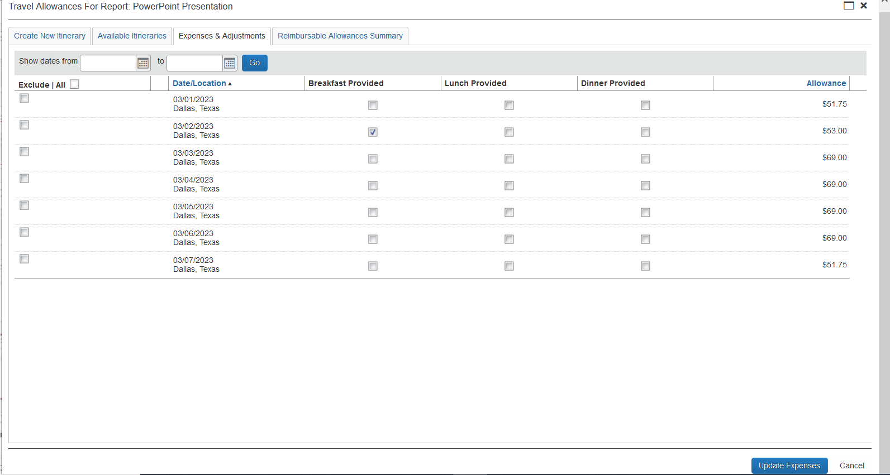
Any meals provided by the conference, or another business associate must be deleted from the per diem by checking the box next to the meal provided. This will adjust the amount of per diem for that day. Click on “create expenses” at the bottom of the screen and it will add the meals to your expense report

Slide 12
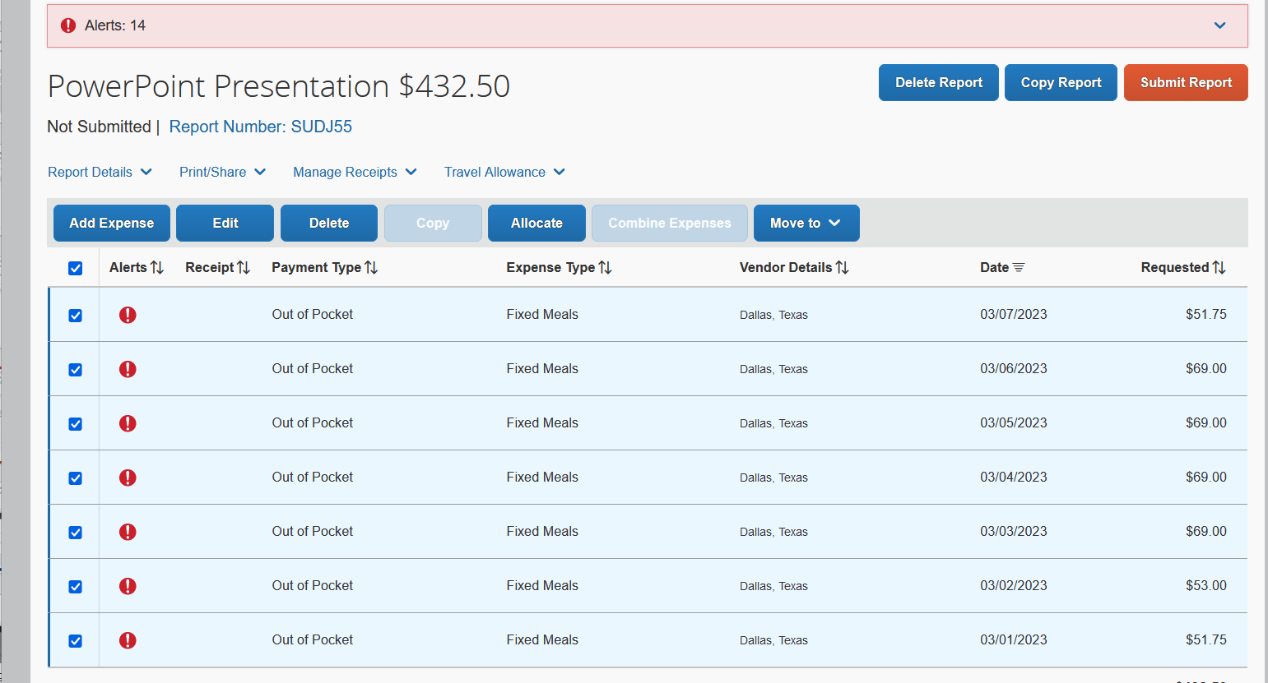
The meals have now been added to the expense report. Assign the Business Purpose and allocate which can be done by clicking in the very top box and it will highlight them all so you can edit them and allocate them all at the same time. .

Slide 13
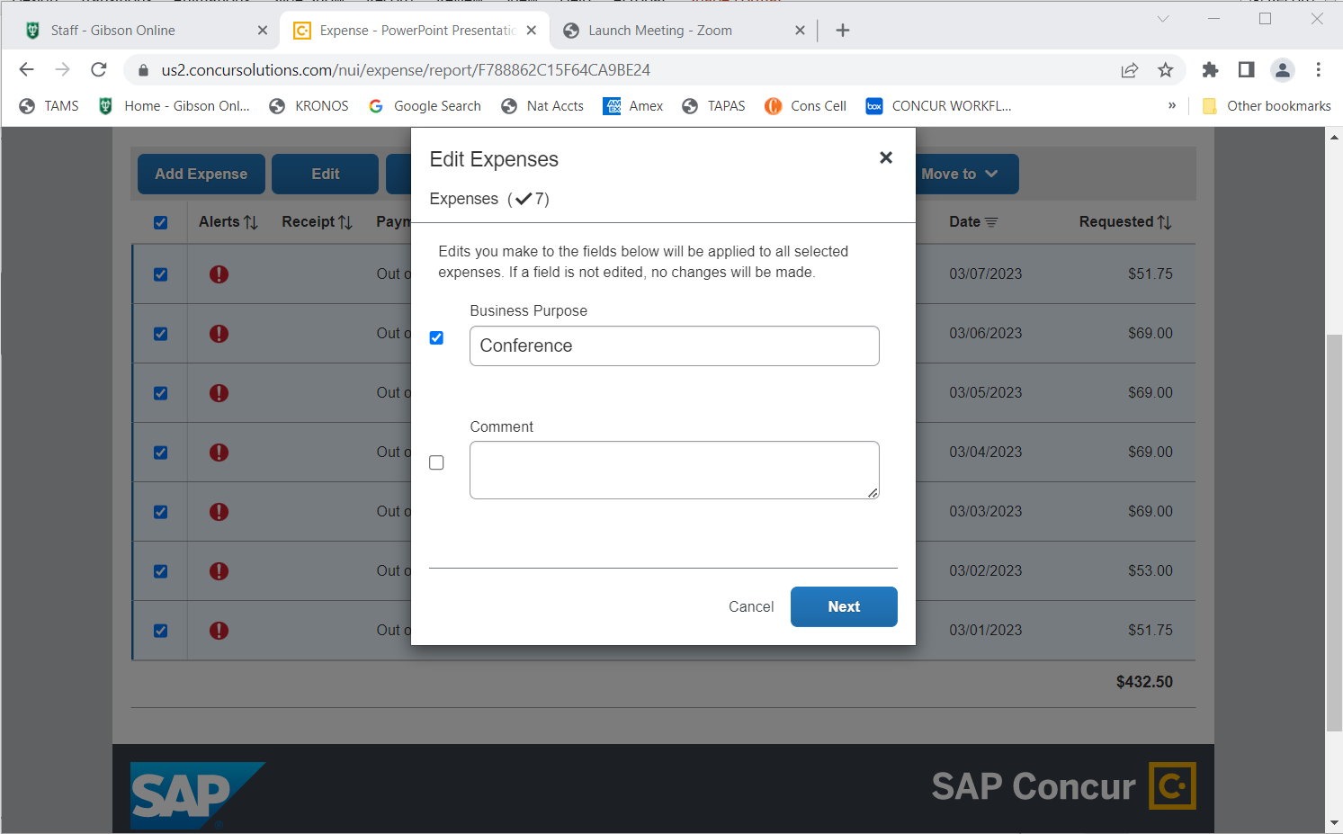
You can now add the business purpose by clicking edit and it will bring up different fields you can edit. Choose “Business Purpose” and then click next, and then save

Slide 14
The per diem meals can now be allocated or allocated with the other expenses after adding all expenses. Click on “allocate” and it will take you to the allocation screen

Slide 15
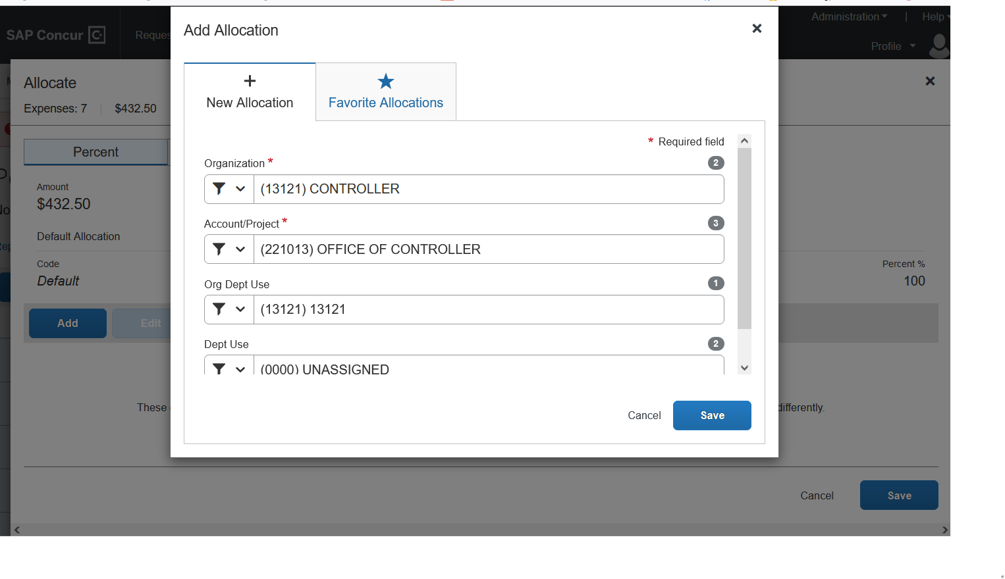
Click on Add and a window will appear with the default information from the report header. If this is the account, you want to allocate to, click save.

Slide 16
If you want to allocate to another Org and account within your division, click on the first Org field and you will see the Orgs you can allocate to. Choose the Org you want to change it to.

Slide 17
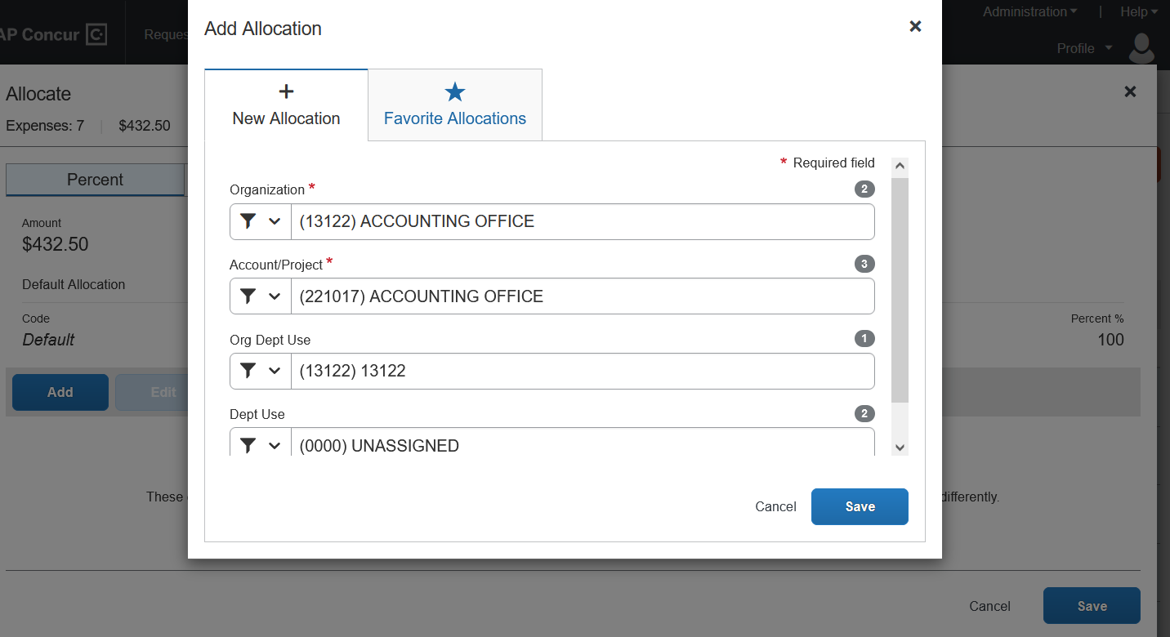
Change the first Org field to the Org you want Click on the account /project field and choose the account you want Click on the Org/Dept Use field and enter the same Org # as the one in the first field. **If these two fields do not match, you’ll get an error message. Reopen and re-enter the Org. Choose (0000) unassigned field in the dept use field and click save

Slide 18
This screen appears after clicking save. Click in the two boxes next to the allocation. Now click save.

Slide 19
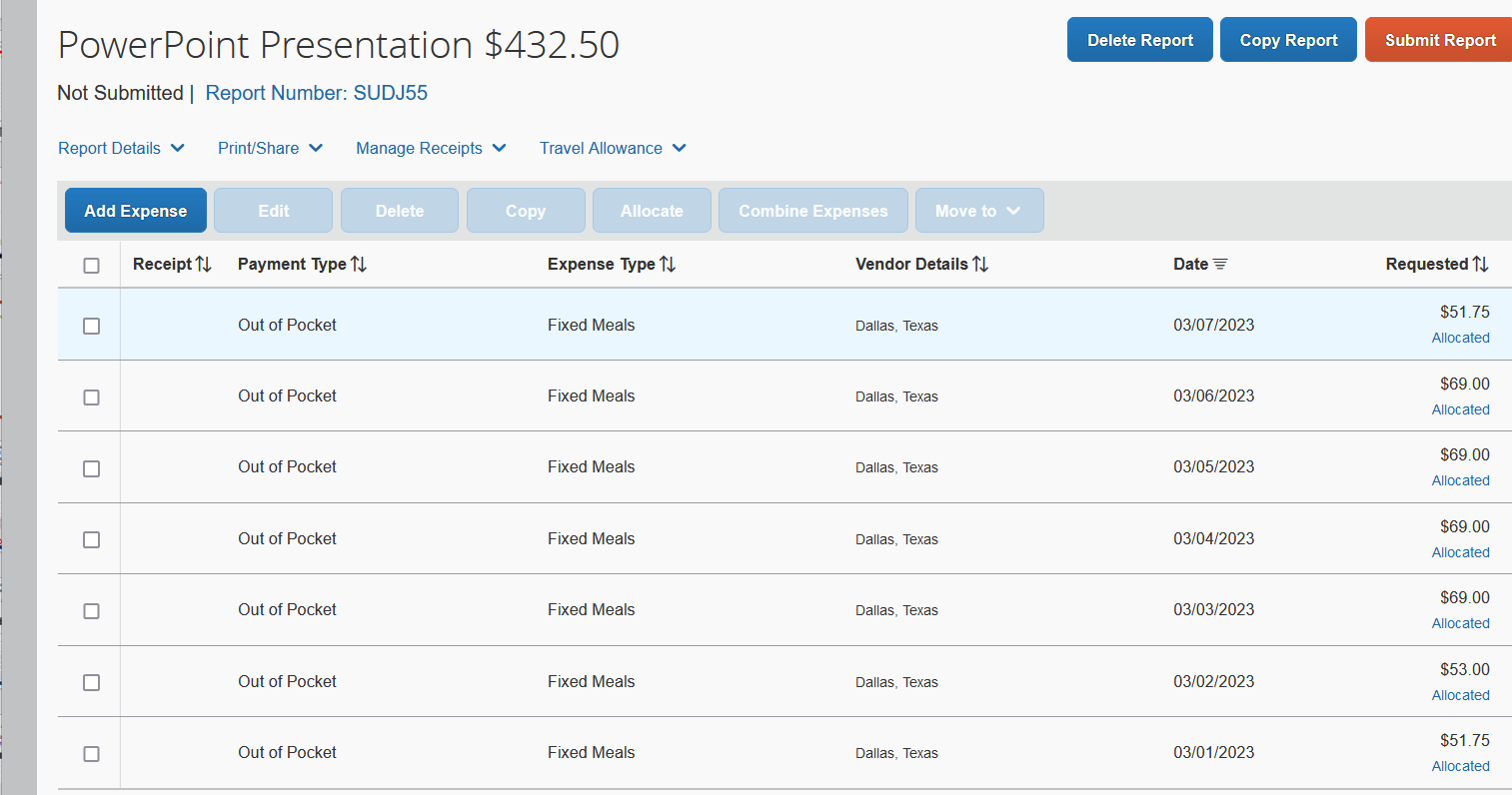
Per diem meals are now complete on the report-there are no alerts Now you will add your expenses to the report from the list of expense types. Choose an expense type and add to your report

Slide 20
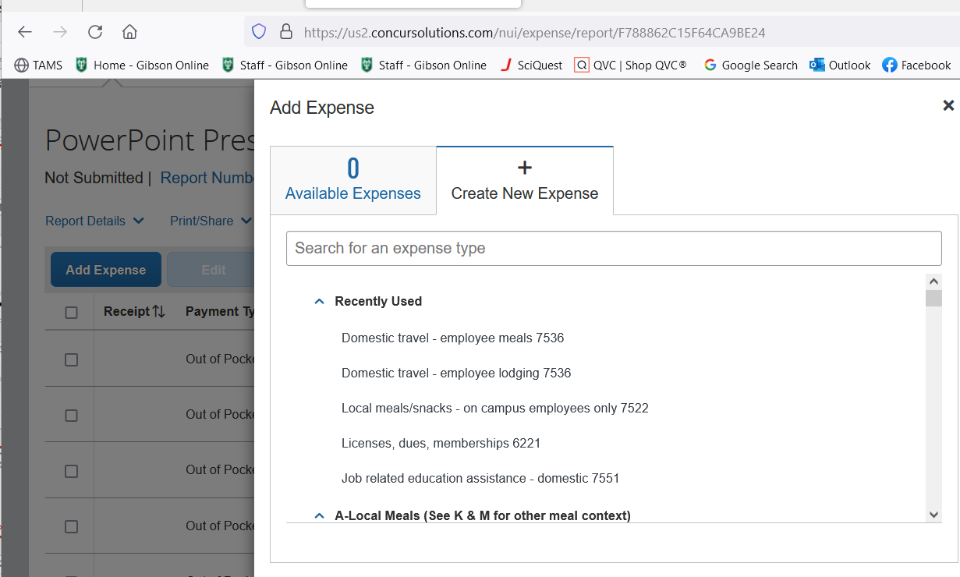
You will now click on Add Expense. A new window will appear with the various expense types, and you click on the one you need. A new window will appear **Note Business Purpose must be valid “business” reason. Reasons such as meal, travel, etc. without specific purpose is not allowed.

Slide 21
You will now click in the box next to the expense Click edit and a new window appears. Fill in all the fields in the detail window Once completed, click save expense.

Slide 22
Once you have completed all fields, click save expense. The next step will be to add the receipt. Click on add receipt

Slide 23
Click on add receipt and another window appears. Click on upload receipt and then browse for the receipt you need and click open The receipt is now being loaded to the receipt area. You can also click add receipt and drag the receipt to the add receipt area and it will load. We have found that sometimes doing it this way, you have to upload twice for it to upload. Click save expense again

Slide 24
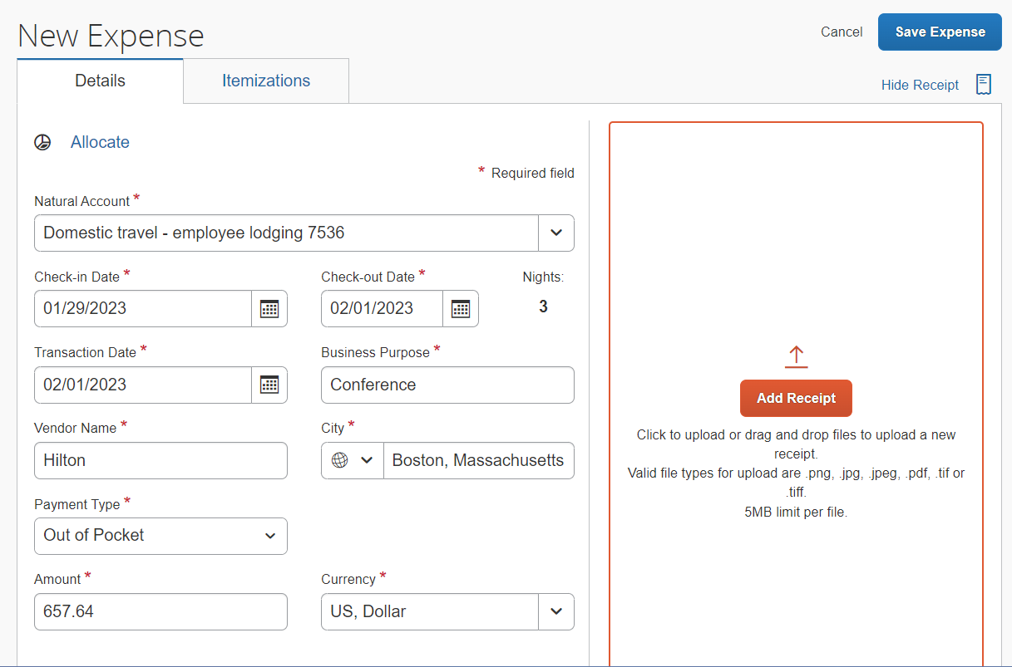
Fill in all fields in expense type box and click on “itemize” Lodging expenses must be itemized. This step requires entering room rates, all taxes, and other items on the hotel receipt. The itemizations must equal the final amount on the hotel receipt.

Slide 25
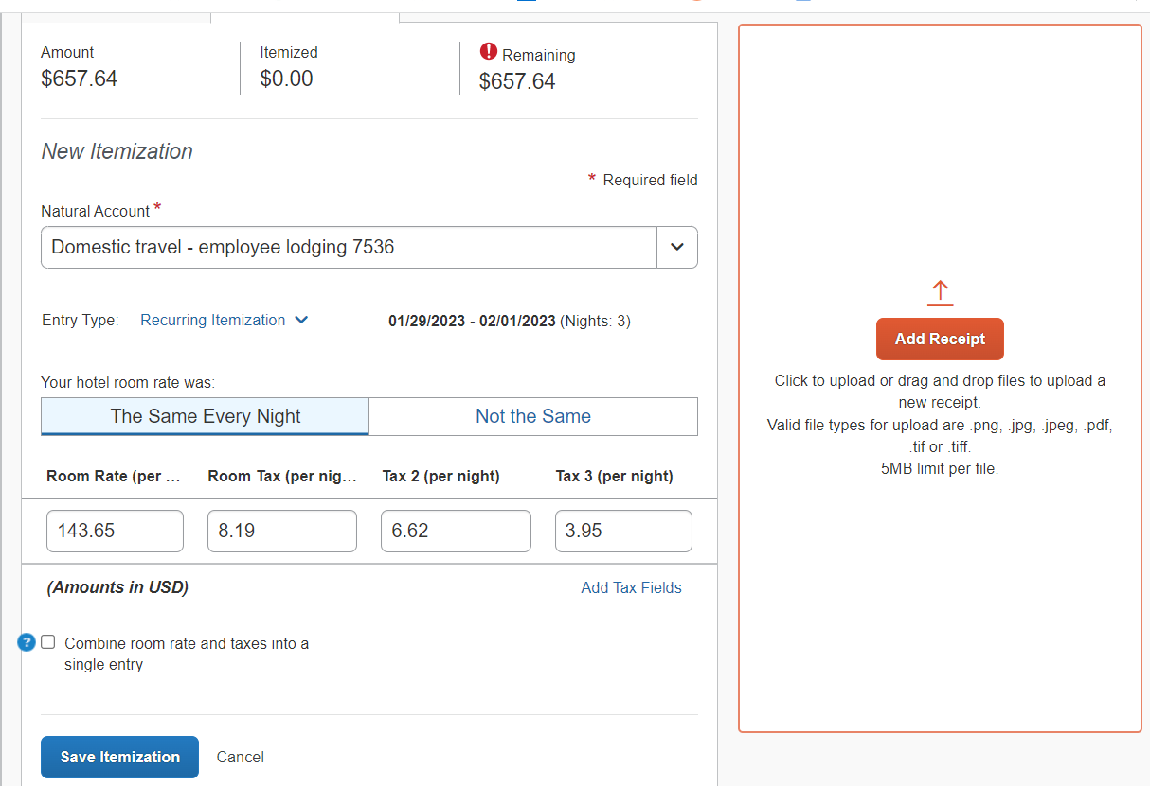
Enter check-in date, check out date ( this field will sometimes have a date, delete and enter check out date) per hotel receipt. System auto-fills the number of days stayed. Enter the rate per night, enter the various taxes in the tax fields. *If there are more than 3 different taxes, add the last taxes together for field “tax 3.” You will see at the top that it has been itemized correctly. The amount in both fields is the same. (Once you hit enter, the amount remaining will be zero. Click on save itemizations

Slide 26
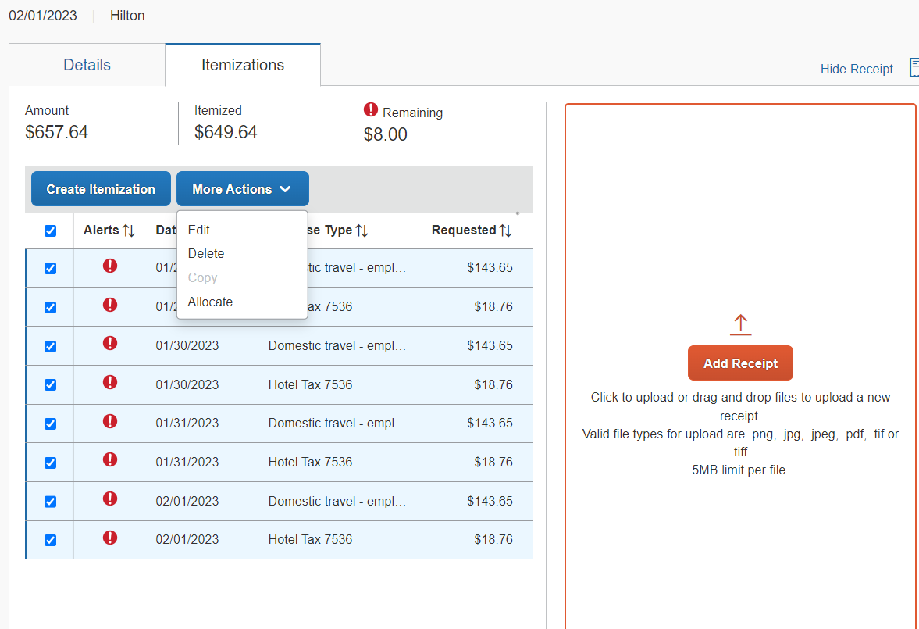
The itemizations now appear in the itemization window with alerts. Click in the top box to highlight all of the itemizations and click on more actions. Click on edit.

Slide 27
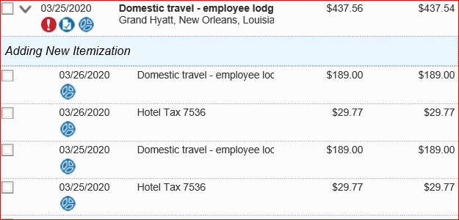
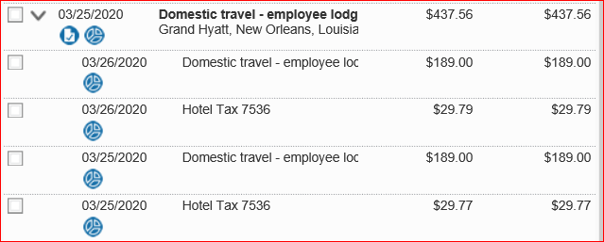
Variations of Hotel Itemizations
Different Rates per Night
Add all the different nights’ rates and divide by the number of nights
This will have to be done with all taxes also as tax rates change when room rates change.
Sometimes the total will not come out matching evenly with the total amount on the receipt. It is usually by cents. Click on one of the hotel tax fields in the report and adjust the tax amount so it matches the receipt total.

Slide 28
Once you click on edit, a window appears and here is where you add the business purpose. Once you have chosen the business purpose, click next at the bottom of the window and it will take you to another window to click save. It will then show the highlighted itemizations again and you will edit and click allocate.

Slide 29
Once again, click on More Actions and then choose allocate. It will then take you to the allocation screen.

Slide 30
Once you are at the allocation screen, click on the add button. The default information from your report header will appear. You can either click save at this point or you can allocate to another Org in your division.

Slide 31
If you choose to charge another Org and account, you stay on the allocation page Click on the first Organization field. This then will bring up a window that will show the Orgs you can allocate to. Change the Org to the one you want to charge.

Slide 32
After filling in the Org you want to change, click on the Account/Proj field and choose the account you need. Go to the Org/Dept Use field and change the Org to match the one you have in the first Org field. You will get an error message if they do not match. Click on the Dept Use field and enter (000) unassigned. If your dept uses Dept Use Codes, enter the one you need. Click save

Slide 33
Once you click save, it will bring you to another dialogue box. Click on the box next to Organization and the box with the account. Once you have looked at it and it is correct, click save and the allocation will be done.

Slide 34
Once you have saved your allocations, it is time to upload the receipt. Click on attach receipt in the window where the itemizations are showing and it will bring up this dialogue box. Click on upload new receipt

Slide 35
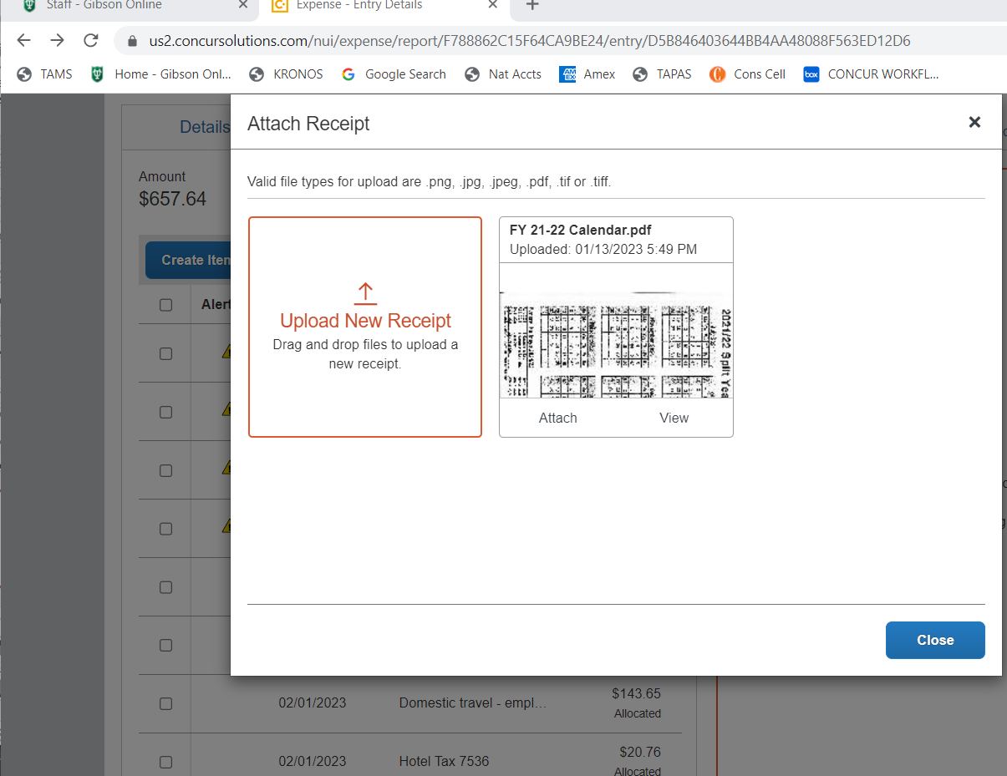
Another dialogue box appears once you click on attach receipt Click on Upload new receipt and it will take you to files on your computer

Slide 36
Now your files appear, and you can click on the receipt you need and click open. Once you click on open the receipt will appear in the receipt window of the expense.

Slide 37
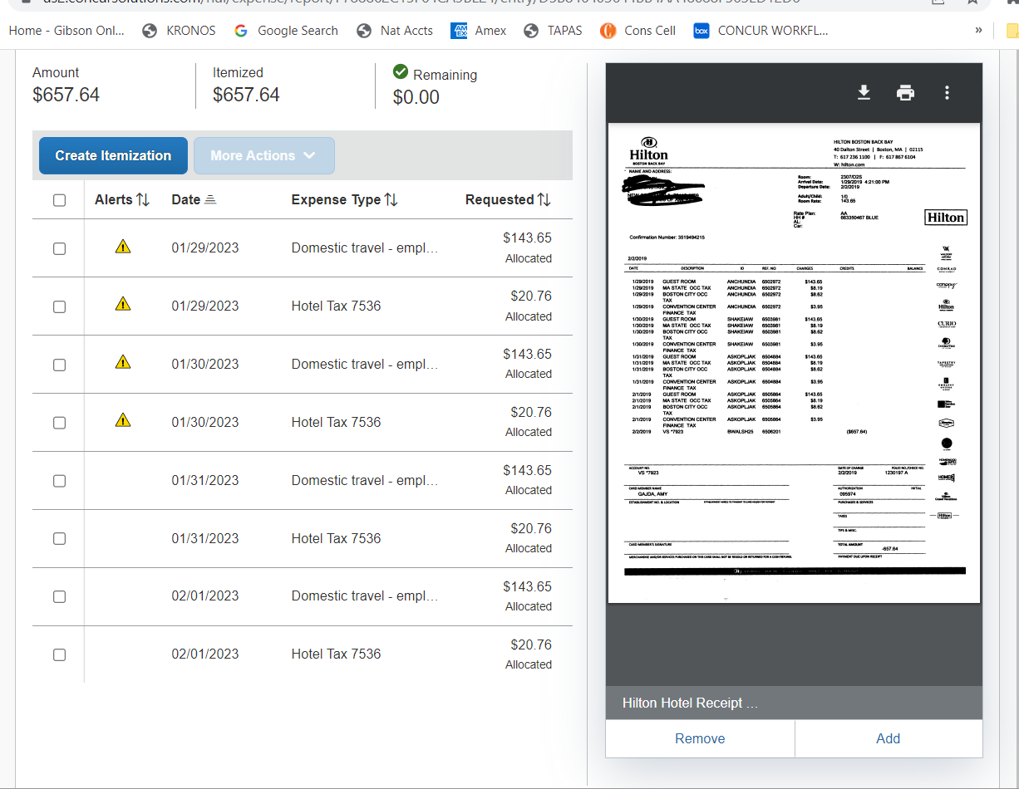
Your receipt is now attached to the expense. **Note- You will see at the bottom of the receipt pane that you and either remove the receipt or add another receipt or other documentation such as an Expense Exception form.

Slide 38
Now click save expense and it will take you back to the screen to add more expenses.

Slide 39
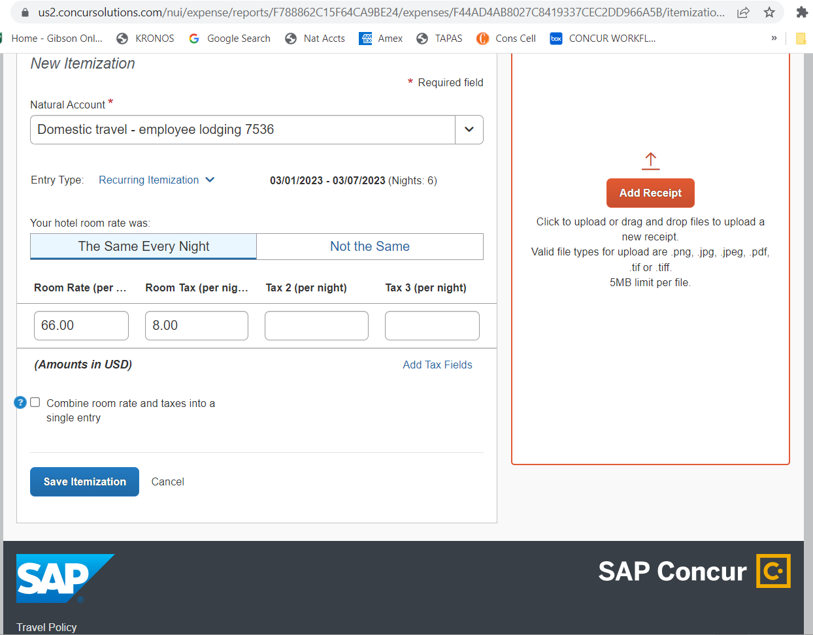
Variations of Hotel Itemizations
AirBnBs are itemized differently due to the way they do their receipts
Example: 5 nights at 66.00/night= $330.00, Taxes =$48.00, Cleaning Fee= 60.00 Total Fees=$438.00
The total room rate and total tax rate are divided by the number of nights and entered in the itemization, save

Slide 40
You will see there is still $60.00 to itemize. Click on create itemization and choose domestic travel employee incidentals Complete all fields and save. The totals will now match

Slide 41
The new itemization for the cleaning fee has now been entered. Click save and totals will match Cleaning fees, and extra charges cannot be entered in the other screen where you add the room rates and taxes because it is not charged each night

Slide 42
Click in the field you need to change and make the changes. In this case, I am changing the report name due to all expenses belonging to a trip. Click on save

Slide 43
Once you have done the itemizations for the AirBnB a new dialogue box opens with the itemizations. Click on more actions and then allocate. Allocate the itemizations and click save

Slide 44
Click on Add The allocation dialogue box appears with your default allocation from the report header. Click save

Slide 45
Adding Transportation Costs Click on add expense, choose domestic travel-employee other transport(you can use Uber, rental cars, taxis, etc. Enter all details. You must put in the comments the purpose of the transport such as hotel to airport, hotel to conference, etc. Click save and enter your next expense.

Slide 46
Employee’s meals are entered under the expense type domestic travel-employee meal. The system will automatically add the attendee for you. All meals require the addition of the attendees. Complete the fields and add receipt. Save

Slide 47
Business Meals are more involved than the domestic travel-employee meal which is used just for the traveler as the only attendee. You must add attendees that attend the business meal. If there many attendees, you will add whatever employees attended, then you create a new attendee and upload the list upload it along with the receipt. .

Slide 48
Once you add several of the attendees, their names appear under attendees. When there are many attendees, you can create a generic attendee and then upload the list along with the receipt Click each attendee and click save.

Slide 49
Once you have added all of your expenses, you will then allocate the expenses. Click on each expense that has not been allocated yet, you can tell by the red exclamation point or over to the right it will show if it has been allocated. Click on Allocate to get to the allocation page.

Slide 50
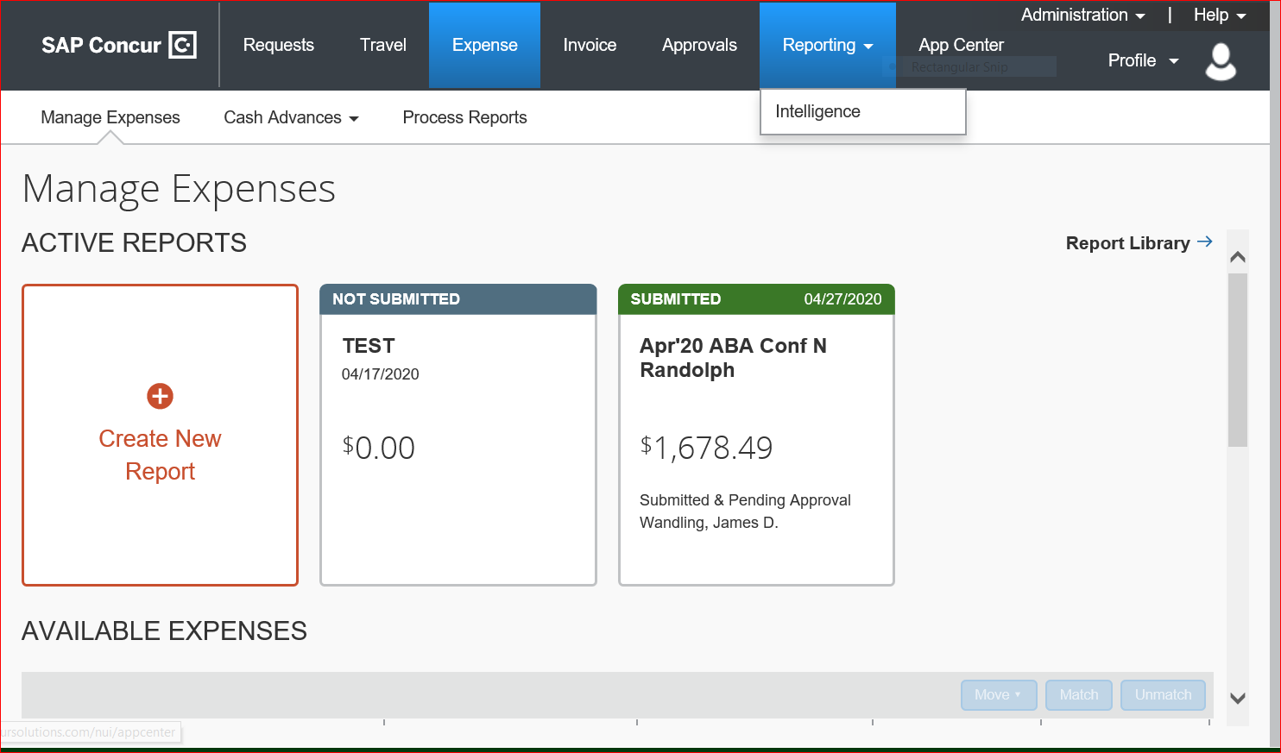
The completed report now appears on the main expense page. It shows the status of submitted and pending approval. Once the report moves through the approval flows, it will move into your report library where you can track the status of the report.

Slide 51
The Allocation screen appears after you click on Allocate Click Add This will bring up the default account allocation from the report header. Click save to choose this account.

Slide 52
Now click in the box next to Organization and next to the account chosen Click Save You can allocate to more than one account by clicking add You can then choose to split the allocation by amount or percent.

Slide 53
Now that all expenses are entered, allocated, and itemized(only hotels require itemization) click on your alerts button to see what is left to do. Red Exclamation Points require adjustments be made to an expense or you cannot submit the report; Yellow alerts usually mean you need an Expense exception form but you must read each alert to see what needs to be done.

Slide 54
Your alerts now appear at the top and explain what each alert needs to be corrected. In this case, all the yellow alerts pertain to the employee lodging and all its itemizations need an Expense Exception Form. You only need to upload one EEF per report regardless of how many times the alert appears. The yellow alert will not disappear once the form is uploaded. It stays so the AP Processor knows to look for one

Slide 55
To add the expense exception form, click on the expense, click edit and it shows the expense details and receipt. Click on Add under the receipt so you can add the EEF Click on save expense once you have uploaded the EEF

Slide 56
The Expense Exception Form is now uploaded with the hotel receipt since this is the expense not done within the 45-day window.

Slide 57
Once you have corrected your alerts and clicked save, the expense report is now ready to submit. If you are acting as a delegate, you will click on notify employee so they can submit. They will receive an email letting them know.

Slide 58
Once you click on submit there is a legal confirmation to read, click on accept & continue. You will see one more screen asking you to submit. A screen appears asking you to review your approver.

Slide 59
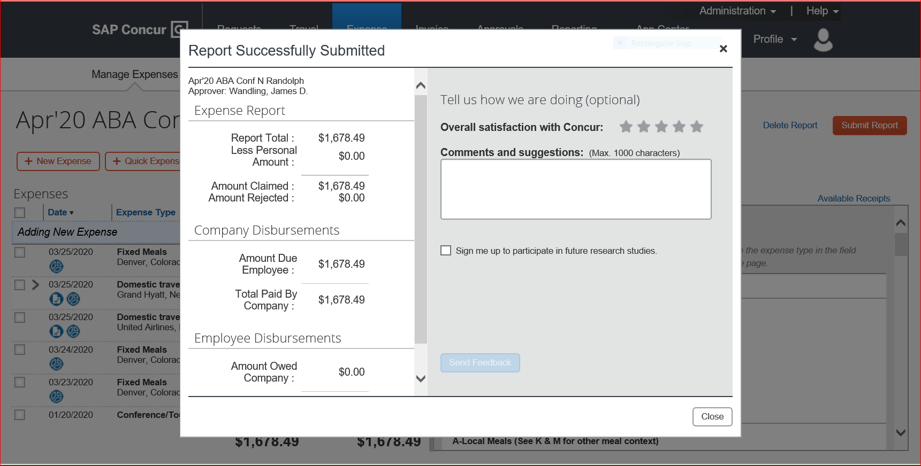
Once you submit the report, this screen appears showing that the report was successfully submitted. You have now completed the report You will now click submit report and this box will appear once submission is complete.

Slide 60
Once you click submit on the approver review screen, your report has been submitted. It will now appear in your Manage Expenses Library and will show you it’s status as it moves through the approval steps. It is now in Pending External Validation and will move to the dept approver when it clears that approval step.

